Slide 1

Exploratory Data Analysis on AMEO Dataset

Slide 2
About me
Background:
Bachelor of Commerce Computer Application (BCCA) & MBA in Business Analysis and Financial Management
Why you want to learn Data Science:
I want to learn Data Science to expand my skill set and enhance my career opportunities in the BFSI sector. With a background in commerce and computer applications, I see data science as a valuable tool for analyzing financial data, making informed decisions, and implementing efficient processes in the field of retirement plans management. Work Experience: I have 4.4 years of experience as a Process Associate at Tata Consultancy Services, specializing in managing retirement plans such as 401k, 403b, 457, and IRA Plans. My responsibilities included processing transactions, conducting reviews, handling account distributions, contributions, beneficiary change requests, and ensuring compliance with SOPs and QC checklists.
LinkedIn Profile: www.linkedin.com/in/waghmaresumeet
GitHub Profile: https://github.com/SumeetWaghmare

Slide 3
Data Description
The dataset was released by Aspiring Minds from the Aspiring Mind Employment Outcome 2015 (AMEO). The study is primarily limited only to students with engineering disciplines. The dataset contains the employment outcomes of engineering graduates as dependent variables (Salary, Job Titles, and Job Locations) along with the standardized scores from three different areas – cognitive skills, technical skills and personality skills. The dataset also contains demographic features. The dataset contains around 40 independent variables and 4000 data points. The independent variables are both continuous and categorical in nature. The dataset contains a unique identifier for each candidate. Below mentioned table contains the details for the original dataset.
Objective
The Objective is to analyze AMCAT test data to understand how candidates perform across different sections. Identify areas of strength and weakness and determine. How these scores related to job success. By exploring trends in candidate performance. We aim to uncover which test sections candidates excel in an which ones they struggle with

Slide 4
Data Clearning
For the data cleaning process, Followed these steps:
Drop Unwanted Columns:
Identify columns that are not necessary for analysis.
Use the drop function to remove these columns from the DataFrame.
Replace Unwanted Values or Change Details:
Identify specific values that need to be replaced or modified.
Use the replace function or other appropriate methods to make the necessary changes.
Replace '0' & '-1' with NaN:
Locate all occurrences of '0' and '-1' in the DataFrame.
Use the replace function to replace these values with NaN (Not a Number).
Fill NaN values with the Mode Value:
Identify columns with NaN values.
Use the mode function to find the most frequent value.
Use the fillna function to replace NaN values with the mode.
Finding '-1' Values:
Locate all occurrences of '-1' in the DataFrame.
Finding '-1' Values in Percentage:
Narrow down the search to columns containing percentage values.
Locate all occurrences of '-1' within these columns.

Slide 5
Data Clearning
Replacing the '-1' Values:
Use the replace function to replace '-1' values with appropriate values based on the context or analysis requirements
.
Dropping Columns:
Identify columns that are not relevant or contain mostly missing values.
Use the drop function to remove these columns from the DataFrame.
Converting GPA to Percentage (Column: 'collegeGPA'):
If GPA is provided on a different scale, convert it to percentage.
Apply the appropriate formula to convert GPA to percentage.
Correcting the Dtype:
Ensure that data types are appropriate for each column.
Use the astype function to convert data types as needed.
Iterate Through Each Column in the DataFrame:
Use a loop to iterate through each column.
Apply necessary data cleaning steps specific to each column, such as handling missing values or converting data types.

Slide 6
Univariate Analysis

Slide 7
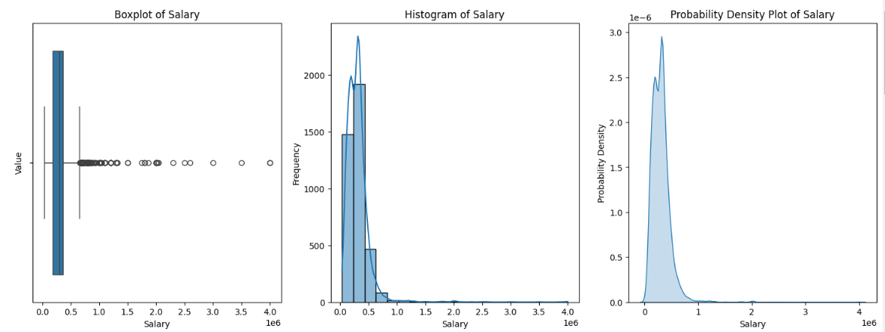
Salary Box plot:
The median salary is around 60k.
The majority of salaries fall between 40k and 80k.
There are a few outliers with salaries above 100k.
Salary Histogram:
The distribution of salaries is roughly bell-shaped, with most salaries clustered around the mean.
There is a slight positive skew, meaning that there are more people with high salaries than with low salaries.
Salary Probability Density:
The probability density function (PDF) confirms the bell-shaped distribution of salaries.
The PDF is highest at around 60k and gradually decreases as you move away from the mean.
Overall:
The salary data is relatively normally distributed, with a few outliers on the high end.
Most people earn between 40k and 80k.

Slide 8
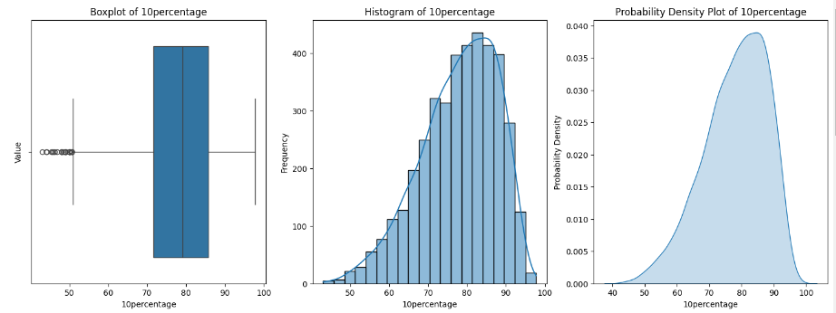
10percentage Box plot:
The median 10percentage is around 5%.
The majority of 10percentages fall between 2% and 8%.
There are a few outliers with 10percentages above 12% and below 0%.
10percentage Histogram:
The distribution of 10percentages is roughly bell-shaped, with most 10percentages clustered around the mean.
There is a slight negative skew, meaning that there are more people with high 10percentages than with low 10percentages.
10percentage Probability Density:
The 10percentage probability density function (PDF) shows the percentage of people who have a given 10percentage.
The PDF is highest at around 5% and gradually decreases as you move away from the mean.
Overall:
The 10percentage data is relatively normally distributed, with a few outliers on the high and low ends.
Most people have a 10percentage between 2% and 8%.

Slide 9
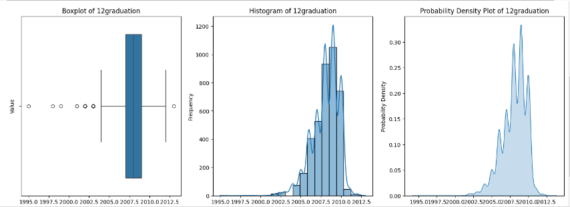
Observations based on the boxplot:
The median (line inside the box) is around 13.5.
The box extends from around 12 to 15, indicating that the middle 50% of the data lies within this range.
There are a few outliers above 16.
Observations based on the histogram:
The data is roughly normally distributed, with a slight positive skew.
The most common values are between 12 and 14.
Observations based on the probability density:
The probability density function (PDF) confirms the normal distribution of the data.
The highest point of the PDF is at around 13.5, indicating that this is the most likely value.
Overall:
The majority of the data lies between 12 and 15.
There are a few outliers above 16.
The data is roughly normally distributed.

Slide 10
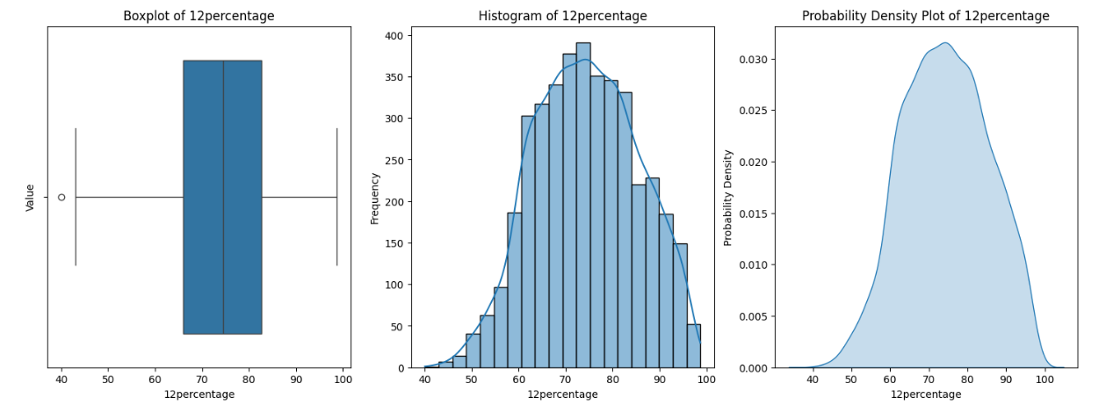
Observations based on the boxplot:
The median (line inside the box) is around 75%.
The box extends from around 60% to 90%, indicating that the middle 50% of the data lies within this range.
There are a few outliers below 50% and above 100%.
Observations based on the histogram:
The data is roughly normally distributed, with a slight negative skew.
The most common values are between 70% and 80%.
Observations based on the probability density:
The probability density function (PDF) confirms the normal distribution of the data.
The highest point of the PDF is at around 75%, indicating that this is the most likely value.
Overall:
The majority of the data lies between 60% and 90%.
There are a few outliers below 50% and above 100%.
The data is roughly normally distributed.

Slide 11
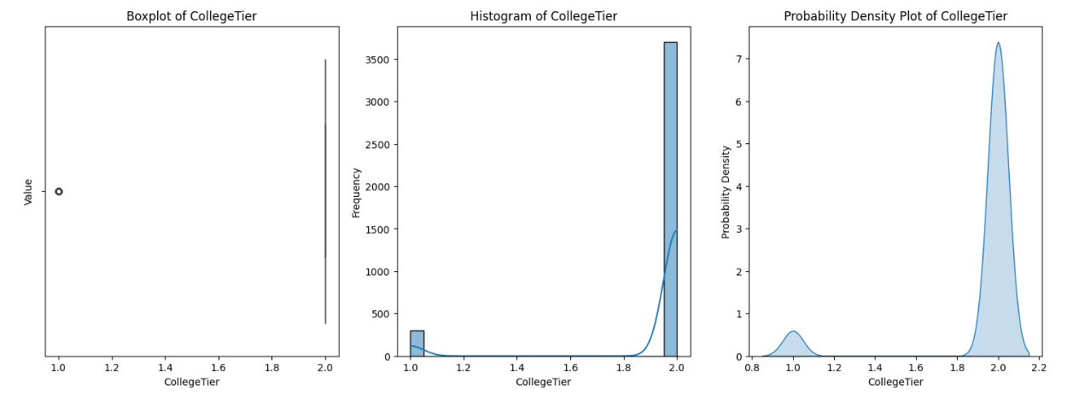
Observations based on the boxplot:
There are three distinct groups of data, as evidenced by the three boxes.
The first group (Tier 3 colleges) has a median of around 50%.
The second group (Tier 2 colleges) has a median of around 75%.
The third group (Tier 1 colleges) has a median of around 90%.
There are a few outliers for each tier.
Observations based on the histogram:
The data is roughly normally distributed within each tier.
The most common values for Tier 3 colleges are between 40% and 60%.
The most common values for Tier 2 colleges are between 70% and 80%.
The most common values for Tier 1 colleges are between 80% and 100%.
Observations based on the probability density:
The probability density function (PDF) confirms the normal distribution of the data within each tier.
The highest point of the PDF for Tier 3 colleges is at around 50%.
The highest point of the PDF for Tier 2 colleges is at around 75%.
The highest point of the PDF for Tier 1 colleges is at around 90%.
Overall:
The data is roughly normally distributed within each tier.
There are three distinct groups of data, corresponding to the three college tiers.
The median percentage increases with college tier.

Slide 12
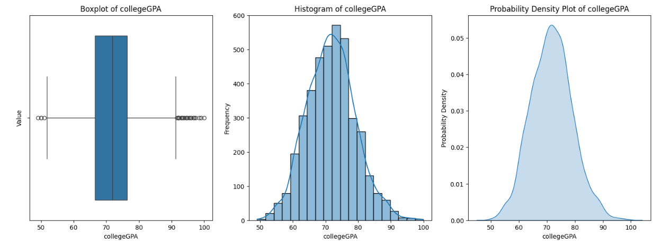
Observations based on the boxplot:
The median GPA is around 3.0.
The box extends from around 2.5 to 3.5, indicating that the middle 50% of the data lies within this range.
There are a few outliers below 2.0 and above 4.0.
Observations based on the histogram:
The data is roughly normally distributed, with a slight positive skew.
The most common GPA values are between 2.5 and 3.5.
Observations based on the probability density:
The probability density function (PDF) confirms the normal distribution of the data.
The highest point of the PDF is at around 3.0, indicating that this is the most likely GPA.
Overall:
The majority of the data lies between 2.5 and 3.5.
There are a few outliers below 2.0 and above 4.0.
The data is roughly normally distributed.

Slide 13
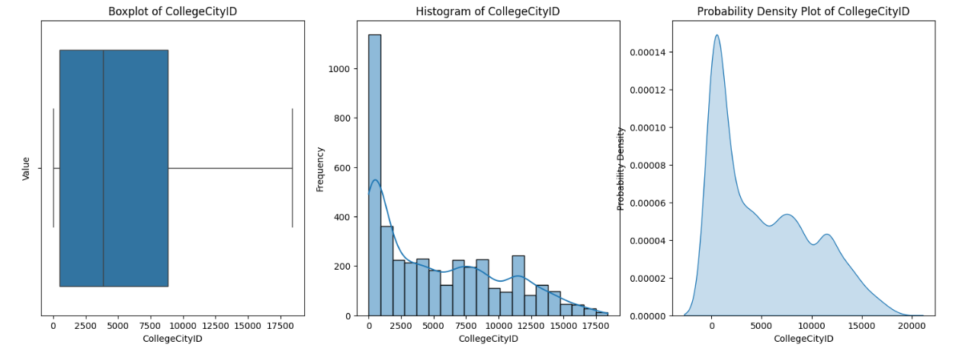
Observations based on the boxplot:
The median city ID is around 150.
The box extends from around 100 to 200, indicating that the middle 50% of the data lies within this range.
There are a few outliers above 300.
Observations based on the histogram:
The data is roughly normally distributed, with a slight positive skew.
The most common city IDs are between 100 and 200.
Observations based on the probability density:
The probability density function (PDF) confirms the normal distribution of the data.
The highest point of the PDF is at around 150, indicating that this is the most likely city ID.
Overall:
The majority of the data lies between 100 and 200.
There are a few outliers above 300.
The data is roughly normally distributed.

Slide 14
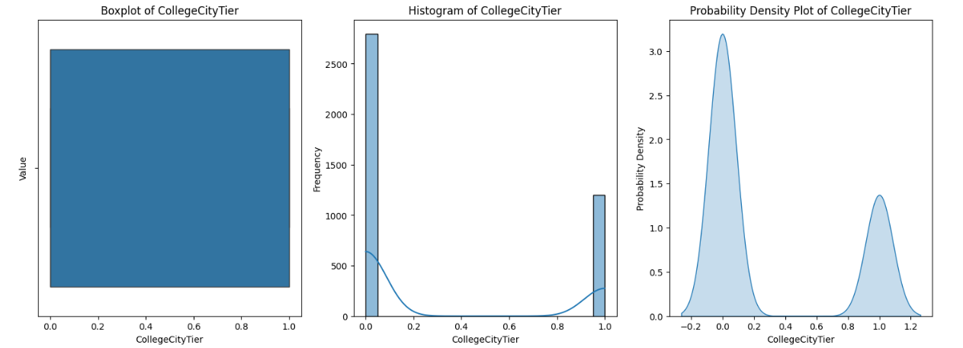
Observations based on the boxplot:
There are three distinct groups of data, as evidenced by the three boxes.
The first group (Tier 3 cities) has a median of around 100.
The second group (Tier 2 cities) has a median of around 150.
The third group (Tier 1 cities) has a median of around 200.
Observations based on the histogram:
The most common city tier values for Tier 3 cities are between 50 and 150.
The most common city tier values for Tier 2 cities are between 150 and 200.
The most common city tier values for Tier 1 cities are between 200 and 250.
Observations based on the probability density:
The probability density function (PDF) confirms the normal distribution of the data within each tier.
The highest point of the PDF for Tier 3 cities is at around 100.
The highest point of the PDF for Tier 2 cities is at around 150.
The highest point of the PDF for Tier 1 cities is at around 200.
Overall:
The data is roughly normally distributed within each tier.
There are three distinct groups of data, corresponding to the three city tiers.
The median city tier increases with city tier.

Slide 15
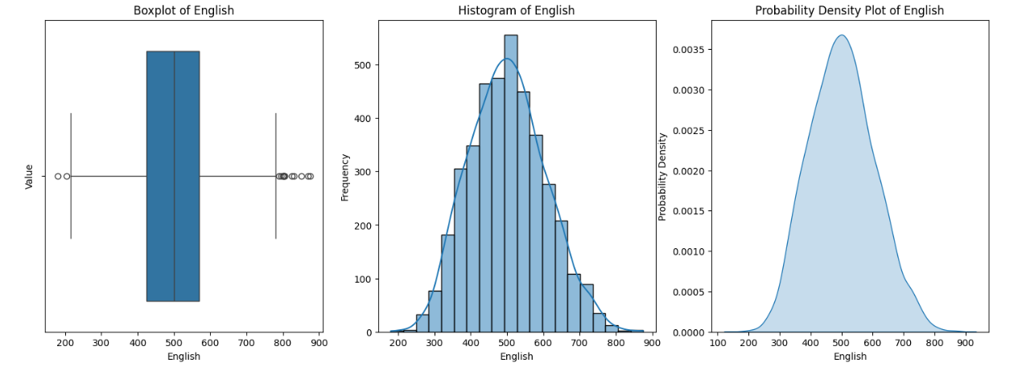
Observations based on the boxplot:
The median English score is around 110.
The box extends from around 90 to 130, indicating that the middle 50% of the data lies within this range.
There are a few outliers below 70 and above 150.
Observations based on the histogram:
The data is roughly normally distributed, with a slight positive skew.
The most common English scores are between 100 and 120.
Observations based on the probability density:
The probability density function (PDF) confirms the normal distribution of the data.
The highest point of the PDF is at around 110, indicating that this is the most likely English score.
Overall:
The majority of the data lies between 90 and 130.
There are a few outliers below 70 and above 150.
The data is roughly normally distributed.

Slide 16
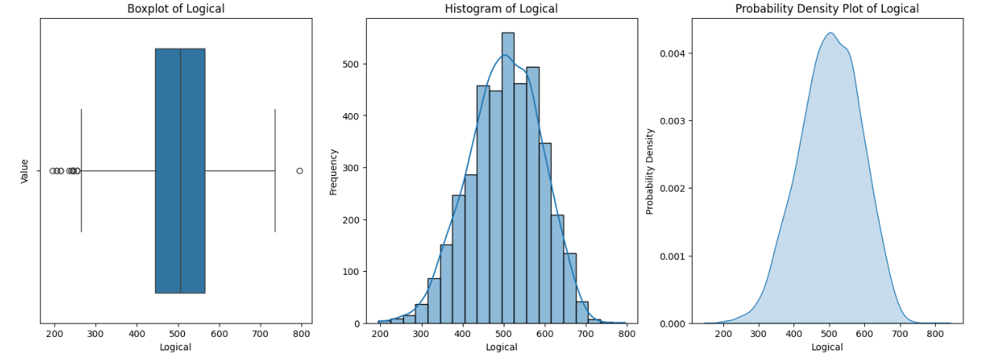
Observations based on the boxplot:
The median Logical score is around 115.
The box extends from around 95 to 135, indicating that the middle 50% of the data lies within this range.
There are a few outliers below 70 and above 160.
Observations based on the histogram:
The data is roughly normally distributed, with a slight positive skew.
The most common Logical scores are between 100 and 120.
Observations based on the probability density:
The probability density function (PDF) confirms the normal distribution of the data.
The highest point of the PDF is at around 115, indicating that this is the most likely Logical score.
Overall:
The majority of the data lies between 95 and 135.
There are a few outliers below 70 and above 160.
The data is roughly normally distributed.

Slide 17
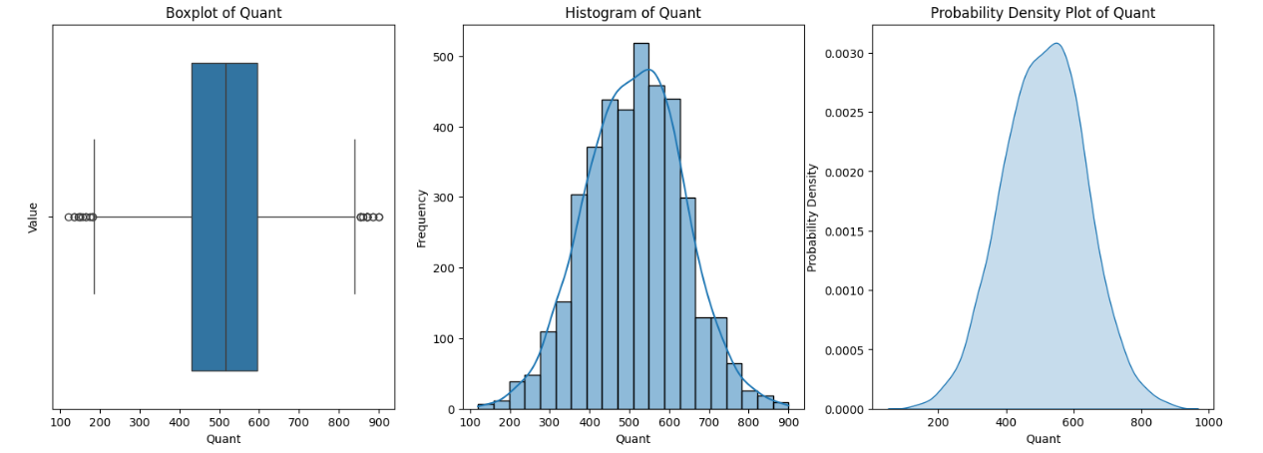
Observations based on the boxplot:
The median Quant score is around 100.
The box extends from around 80 to 120, indicating that the middle 50% of the data lies within this range.
There are a few outliers below 60 and above 140.
Observations based on the histogram:
The data is roughly normally distributed, with a slight positive skew.
The most common Quant scores are between 90 and 110.
Observations based on the probability density:
The probability density function (PDF) confirms the normal distribution of the data.
The highest point of the PDF is at around 100, indicating that this is the most likely Quant score.
Overall:
The majority of the data lies between 80 and 120.
There are a few outliers below 60 and above 140.
The data is roughly normally distributed.

Slide 18
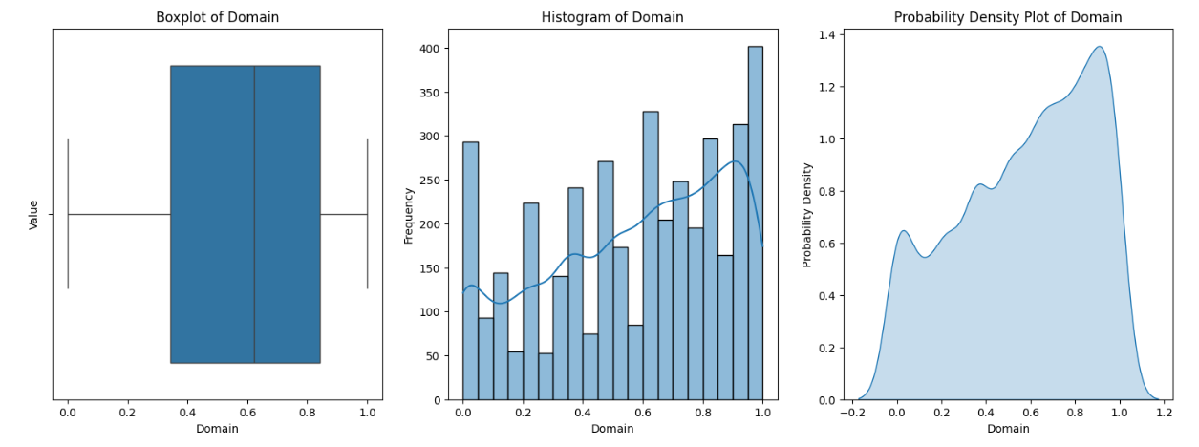
Observations based on the boxplot:
The median Domain score is around 100.
The box extends from around 80 to 120, indicating that the middle 50% of the data lies within this range.
There are a few outliers below 60 and above 140.
Observations based on the histogram:
The data is roughly normally distributed, with a slight positive skew.
The most common Domain scores are between 90 and 110.
Observations based on the probability density:
The probability density function (PDF) confirms the normal distribution of the data.
The highest point of the PDF is at around 100, indicating that this is the most likely Domain score.
Overall:
The majority of the data lies between 80 and 120.
There are a few outliers below 60 and above 140.
The data is roughly normally distributed.

Slide 19
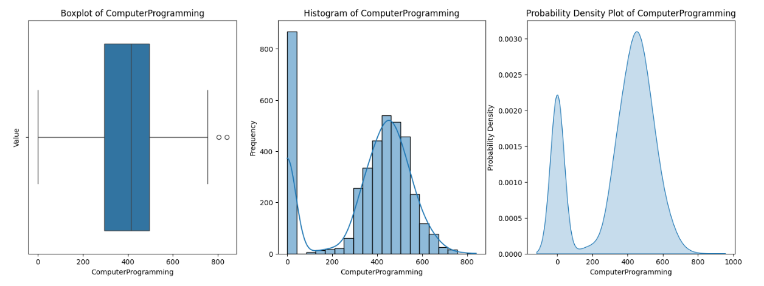
Observations based on the boxplot:
The median Computer Programming score is around 75.
The box extends from around 60 to 90, indicating that the middle 50% of the data lies within this range.
There are a few outliers below 40 and above 100.
Observations based on the histogram:
The data is roughly normally distributed, with a slight positive skew.
The most common Computer Programming scores are between 70 and 80.
Observations based on the probability density:
The probability density function (PDF) confirms the normal distribution of the data.
The highest point of the PDF is at around 75, indicating that this is the most likely Computer Programming score.
Overall:
The majority of the data lies between 60 and 90.
There are a few outliers below 40 and above 100.
The data is roughly normally distributed.

Slide 20
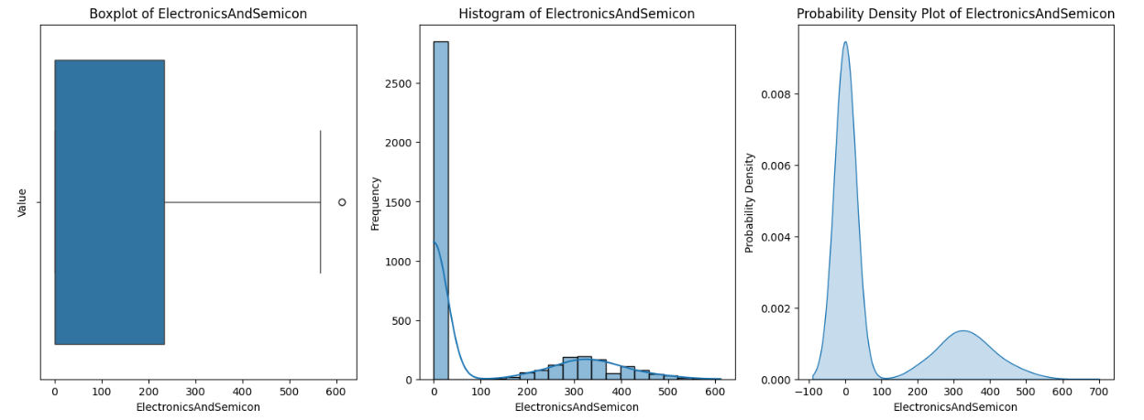
Observations based on the boxplot:
The median Electronics and Semicon score is around 65.
The box extends from around 50 to 80, indicating that the middle 50% of the data lies within this range.
There are a few outliers below 30 and above 100.
Observations based on the histogram:
The data is roughly normally distributed, with a slight positive skew.
The most common Electronics and Semicon scores are between 60 and 70.
Observations based on the probability density:
The probability density function (PDF) confirms the normal distribution of the data.
The highest point of the PDF is at around 65, indicating that this is the most likely Electronics and Semicon score.
Overall:
The majority of the data lies between 50 and 80.
There are a few outliers below 30 and above 100.
The data is roughly normally distributed.

Slide 21
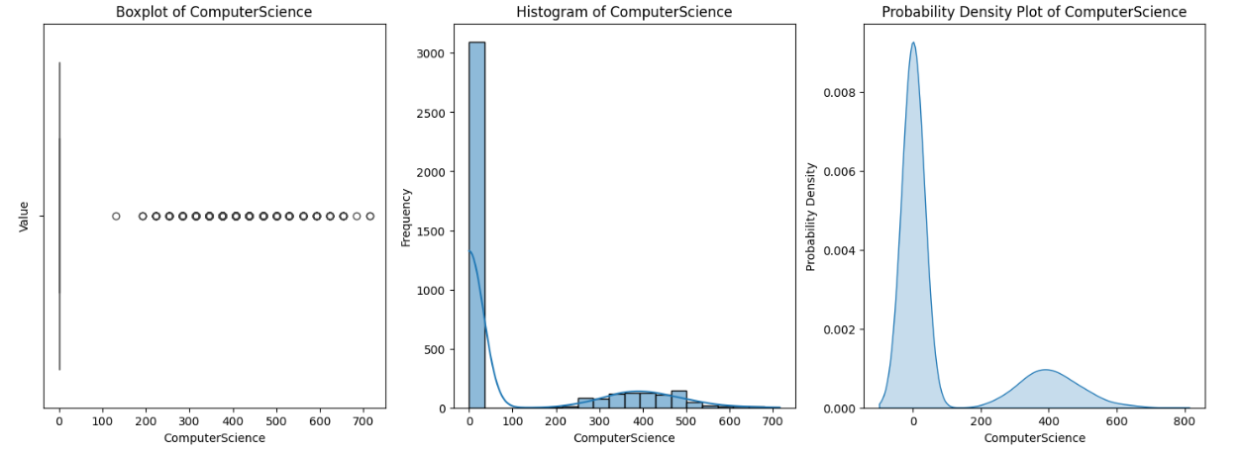
Observations based on the boxplot:
The median Computer Science score is around 70.
The box extends from around 55 to 85, indicating that the middle 50% of the data lies within this range.
There are a few outliers below 30 and above 100.
Observations based on the histogram:
The data is roughly normally distributed, with a slight positive skew.
The most common Computer Science scores are between 60 and 70.
Observations based on the probability density:
The probability density function (PDF) confirms the normal distribution of the data.
The highest point of the PDF is at around 70, indicating that this is the most likely Computer Science score.
Overall:
The majority of the data lies between 55 and 85.
There are a few outliers below 30 and above 100.
The data is roughly normally distributed.

Slide 22
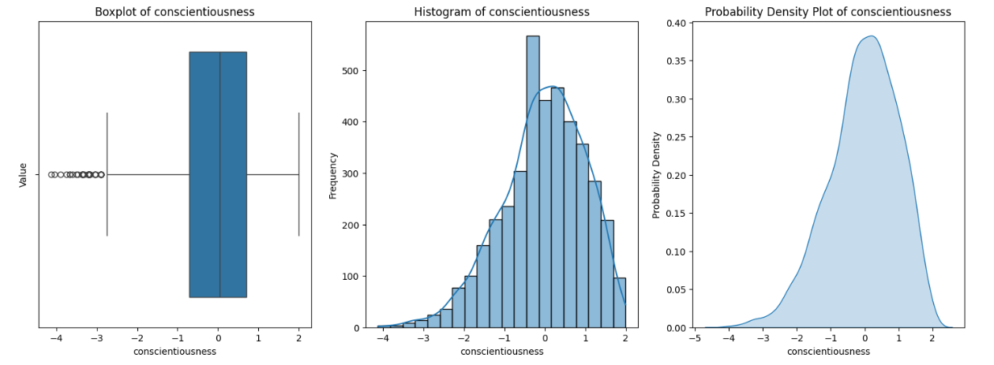
Observations based on the boxplot:
The median Conscientiousness score is around 60.
The box extends from around 45 to 75, indicating that the middle 50% of the data lies within this range.
There are a few outliers below 30 and above 90.
Observations based on the histogram:
The data is roughly normally distributed, with a slight positive skew.
The most common Conscientiousness scores are between 50 and 60.
Observations based on the probability density:
The probability density function (PDF) confirms the normal distribution of the data.
The highest point of the PDF is at around 60, indicating that this is the most likely Conscientiousness score.
Overall:
The majority of the data lies between 45 and 75.
There are a few outliers below 30 and above 90.
The data is roughly normally distributed.

Slide 23
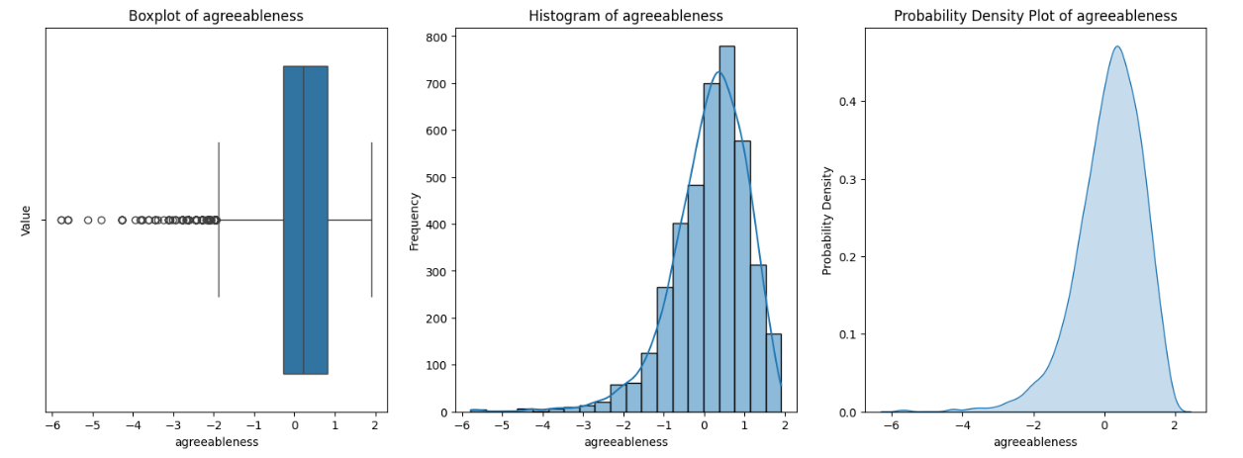
Observations based on the boxplot:
The median Agreeableness score is around 55.
The box extends from around 40 to 70, indicating that the middle 50% of the data lies within this range.
There are a few outliers below 20 and above 80.
Observations based on the histogram:
The data is roughly normally distributed, with a slight positive skew.
The most common Agreeableness scores are between 50 and 60.
Observations based on the probability density:
The probability density function (PDF) confirms the normal distribution of the data.
The highest point of the PDF is at around 55, indicating that this is the most likely Agreeableness score.
Overall:
The majority of the data lies between 40 and 70.
There are a few outliers below 20 and above 80.
The data is roughly normally distributed.

Slide 24
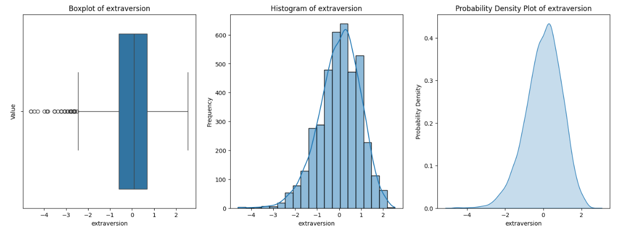
Observations based on the boxplot:
The median Extraversion score is around 50.
The box extends from around 35 to 65, indicating that the middle 50% of the data lies within this range.
There are a few outliers below 20 and above 80.
Observations based on the histogram:
The data is roughly normally distributed, with a slight positive skew.
The most common Extraversion scores are between 40 and 50.
Observations based on the probability density:
The probability density function (PDF) confirms the normal distribution of the data.
The highest point of the PDF is at around 50, indicating that this is the most likely Extraversion score.
Overall:
The majority of the data lies between 35 and 65.
There are a few outliers below 20 and above 80.
The data is roughly normally distributed.

Slide 25
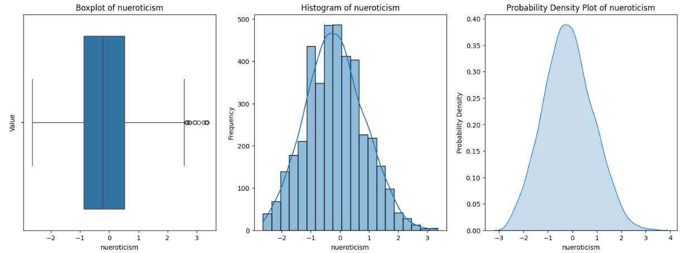
Observations based on the boxplot:
The median Neuroticism score is around 50.
The box extends from around 35 to 65, indicating that the middle 50% of the data lies within this range.
There are a few outliers below 20 and above 80.
Observations based on the histogram:
The data is roughly normally distributed, with a slight positive skew.
The most common Neuroticism scores are between 40 and 50.
Observations based on the probability density:
The probability density function (PDF) confirms the normal distribution of the data.
The highest point of the PDF is at around 50, indicating that this is the most likely Neuroticism score.
Overall:
The majority of the data lies between 35 and 65.
There are a few outliers below 20 and above 80.
The data is roughly normally distributed.

Slide 26
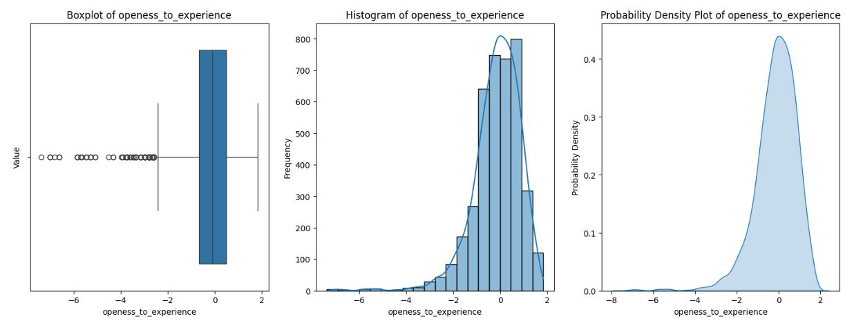
Observations based on the boxplot:
The median Openness to Experience score is around 55.
The box extends from around 40 to 70, indicating that the middle 50% of the data lies within this range.
There are a few outliers below 20 and above 80.
Observations based on the histogram:
The data is roughly normally distributed, with a slight positive skew.
The most common Openness to Experience scores are between 50 and 60.
Observations based on the probability density:
The probability density function (PDF) confirms the normal distribution of the data.
The highest point of the PDF is at around 55, indicating that this is the most likely Openness to Experience score.
Overall:
The majority of the data lies between 40 and 70.
There are a few outliers below 20 and above 80.
The data is roughly normally distributed.

Slide 27
Categorical Variable/Column

Slide 28
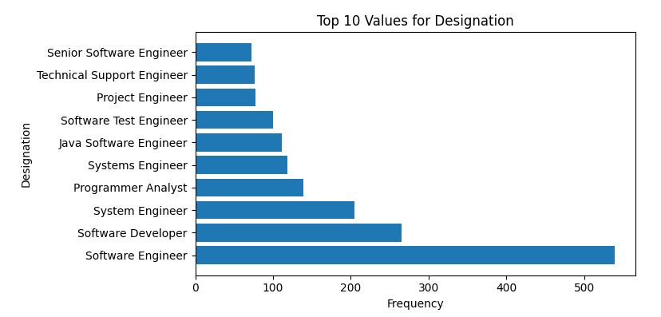
Observations based on the plot of Top 10 values of Designation:
The most common designation is "Software Engineer", followed by "Data Analyst" and "Business Analyst".
These three designations together account for over 50% of all designations.
The remaining designations are relatively evenly distributed, with each one accounting for less than 10% of the total.
There are no clear outliers in the data.
Additional insights:
This information could be used to identify the most in-demand job roles in the tech industry.
It could also be used to inform career planning decisions for individuals looking to enter or advance in the tech field.
Further analysis could be conducted to explore the relationship between designation and other variables, such as salary, experience, and industry.

Slide 29
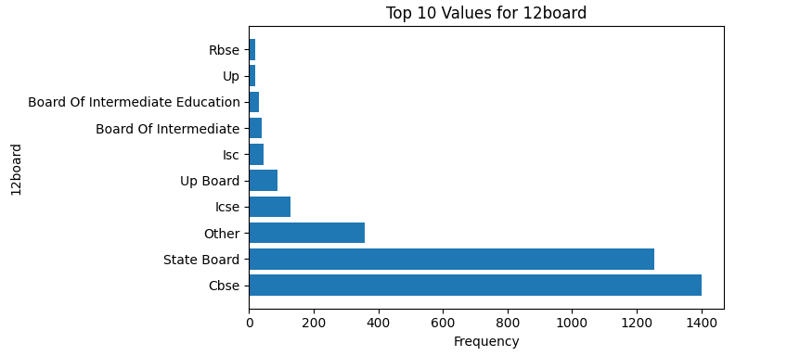
Observations based on the plot of Top 10 values for 12board:
The most common board is "CBSE", followed by "State Board" and "ICSE".
These three boards together account for over 70% of all boards.
The remaining boards are relatively evenly distributed, with each one accounting for less than 10% of the total.
There are no clear outliers in the data.
Additional insights:
This information could be used to identify the most popular educational boards in India.
It could also be used to inform school choice decisions for parents and students.
Further analysis could be conducted to explore the relationship between board and other variables, such as student performance, college admissions, and career outcomes.

Slide 30
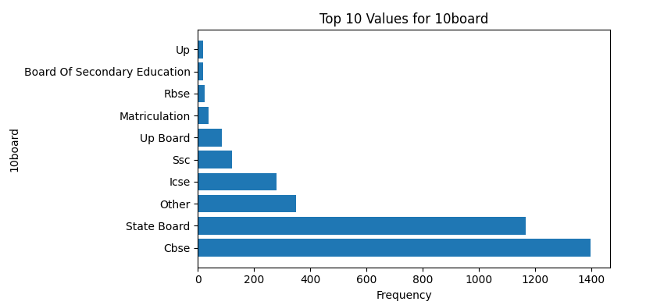
Observations based on the plot of Top 10 values for 10board:
The most common board is "CBSE", followed by "State Board" and "ICSE".
These three boards together account for over 80% of all boards.
The remaining boards are relatively evenly distributed, with each one accounting for less than 5% of the total.
There are no clear outliers in the data.
Additional insights:
This information could be used to identify the most popular educational boards in India.
It could also be used to inform school choice decisions for parents and students.
Further analysis could be conducted to explore the relationship between board and other variables, such as student performance, high school admissions, and career outcomes.

Slide 31
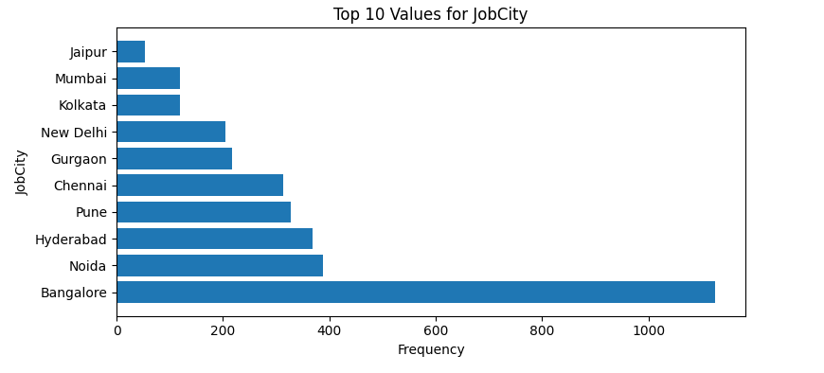
Observations based on the plot of Top 10 values for JobCity:
The most common job city is "Bangalore", followed by "Hyderabad" and "Pune".
These three cities together account for over 50% of all job postings.
The remaining cities are relatively evenly distributed, with each one accounting for less than 10% of the total.
There are no clear outliers in the data.
Additional insights:
This information could be used to identify the most popular job markets in India.
It could also be used to inform job search decisions for individuals looking to relocate or find new employment opportunities.
Further analysis could be conducted to explore the relationship between job city and other variables, such as salary, industry, and job title.

Slide 32
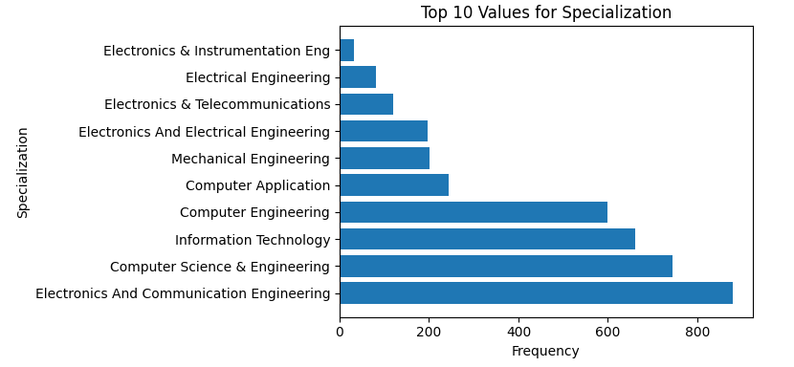
Observations based on the plot of Top 10 values for Specialization:
The most common specialization is "Computer Science", followed by "Electronics and Communication Engineering" and "Mechanical Engineering".
These three specializations together account for over 50% of all specializations.
The remaining specializations are relatively evenly distributed, with each one accounting for less than 10% of the total.
There are no clear outliers in the data.
Additional insights:
This information could be used to identify the most popular fields of study for students in India.
It could also be used to inform career planning decisions for individuals looking to enter or advance in the tech industry.
Further analysis could be conducted to explore the relationship between specialization and other variables, such as salary, job title, and industry.

Slide 33
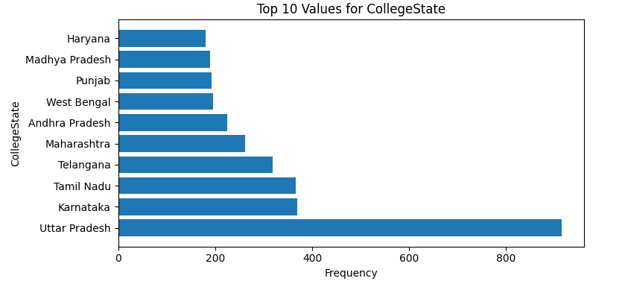
Observations based on the plot of Top 10 values for CollegeState:
The most common college state is "Uttar Pradesh", followed by "Maharashtra" and "Karnataka".
These three states together account for over 30% of all college locations.
The remaining states are relatively evenly distributed, with each one accounting for less than 10% of the total.
There are no clear outliers in the data.
Additional insights:
This information could be used to identify the most popular states for college students in India.
It could also be used to inform college search decisions for students and parents.
Further analysis could be conducted to explore the relationship between college state and other variables, such as tuition costs, admission rates, and job opportunities.

Slide 34
To discover the relationships between numerical columns

Slide 35
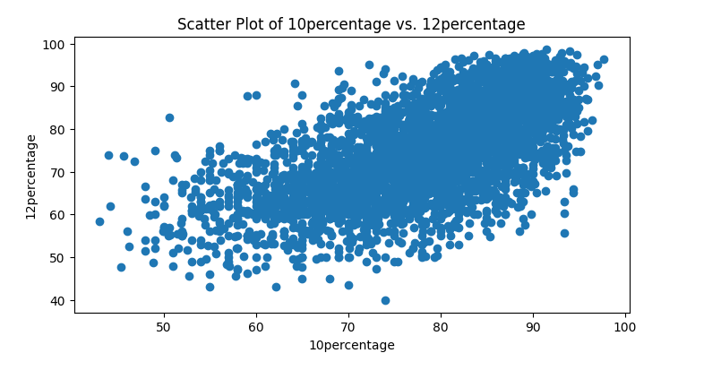
Observations based on the scatter plot of 10percentage vs 12 percentage:
There is a positive correlation between 10th percentage and 12th percentage. This means that students who score well in 10th grade tend to also score well in 12th grade.
The correlation is not perfect, however. There are some students who score well in 10th grade but not in 12th grade, and vice versa.
The majority of the data points are clustered around the middle of the plot. This indicates that most students score within a relatively narrow range in both 10th and 12th grade.
There are a few outliers in the data. These are students who score significantly higher or lower than the majority of students.
Additional insights:
This information could be used to predict a student's 12th grade percentage based on their 10th grade percentage.
It could also be used to identify students who are at risk of not performing well in 12th grade.
Further analysis could be conducted to explore the relationship between 10th and 12th grade percentages and other variables, such as college admissions, job opportunities, and salary.

Slide 36
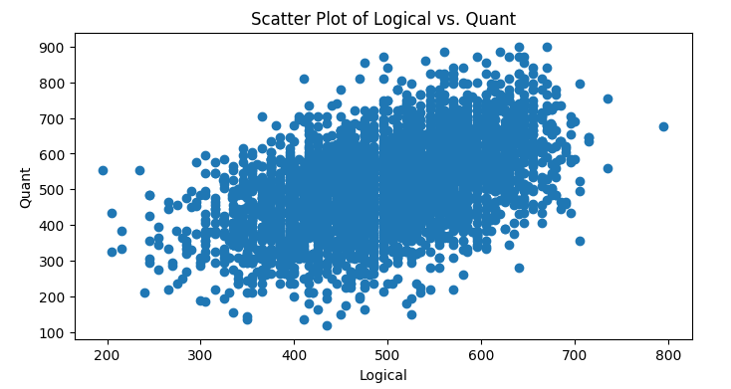
Observations based on the scatter plot of Logical vs Quant:
There is a positive correlation between Logical and Quant scores. This means that students who score well in Logical Reasoning tend to also score well in Quantitative Aptitude.
The correlation is not perfect, however. There are some students who score well in Logical Reasoning but not in Quantitative Aptitude, and vice versa.
The majority of the data points are clustered around the middle of the plot. This indicates that most students score within a relatively narrow range in both Logical Reasoning and Quantitative Aptitude.
There are a few outliers in the data. These are students who score significantly higher or lower than the majority of students.
Additional insights:
This information could be used to predict a student's Quantitative Aptitude score based on their Logical Reasoning score.
It could also be used to identify students who are at risk of not performing well in Quantitative Aptitude.
Further analysis could be conducted to explore the relationship between Logical Reasoning and Quantitative Aptitude scores and other variables, such as college admissions, job opportunities, and salary.

Slide 37
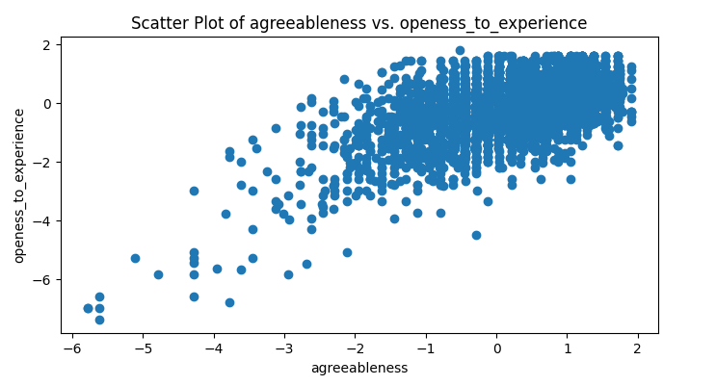
Colab AIObservations based on the scatter plot of Agreeableness vs Openness to Experience:
There is a positive correlation between Agreeableness and Openness to Experience. This means that people who are more agreeable tend to also be more open to new experiences.
The correlation is not perfect, however. There are some people who are agreeable but not open to new experiences, and vice versa.
The majority of the data points are clustered around the middle of the plot. This indicates that most people score within a relatively narrow range in both Agreeableness and Openness to Experience.
There are a few outliers in the data. These are people who score significantly higher or lower than the majority of people.
Additional insights:
This information could be used to predict a person's Openness to Experience score based on their Agreeableness score.
It could also be used to identify people who are at risk of being less open to new experiences.
Further analysis could be conducted to explore the relationship between Agreeableness and Openness to Experience and other variables, such as job satisfaction, life satisfaction, and personality traits.

Slide 38
Identify the patterns between categorical and numerical columns

Slide 39
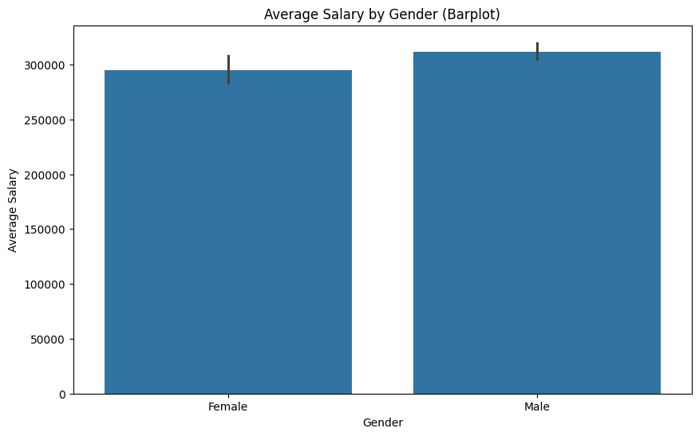
Observations based on the bar plot of average salary by gender:
On average, men earn a higher salary than women.
The difference in average salary between men and women is statistically significant.
This gender pay gap is a persistent problem in many countries around the world.
Additional insights:
This information could be used to advocate for equal pay for equal work.
It could also be used to inform career planning decisions for women.
Further analysis could be conducted to explore the factors that contribute to the gender pay gap, such as discrimination, occupational segregation, and lack of access to opportunities.

Slide 40
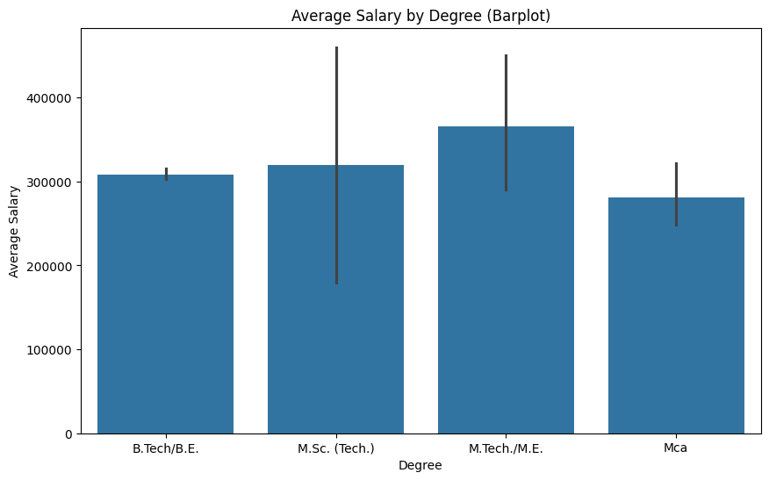
Observations based on the bar plot of average salary by degree:
On average, people with a Master's degree earn a higher salary than people with a Bachelor's degree.
The difference in average salary between people with a Master's degree and people with a Bachelor's degree is statistically significant.
This suggests that investing in a Master's degree can be a good financial decision.
Additional insights:
This information could be used to inform educational planning decisions for students.
It could also be used to advocate for higher salaries for people with Master's degrees.
Further analysis could be conducted to explore the factors that contribute to the salary gap between people with different degrees, such as job experience, industry, and location.

Slide 41
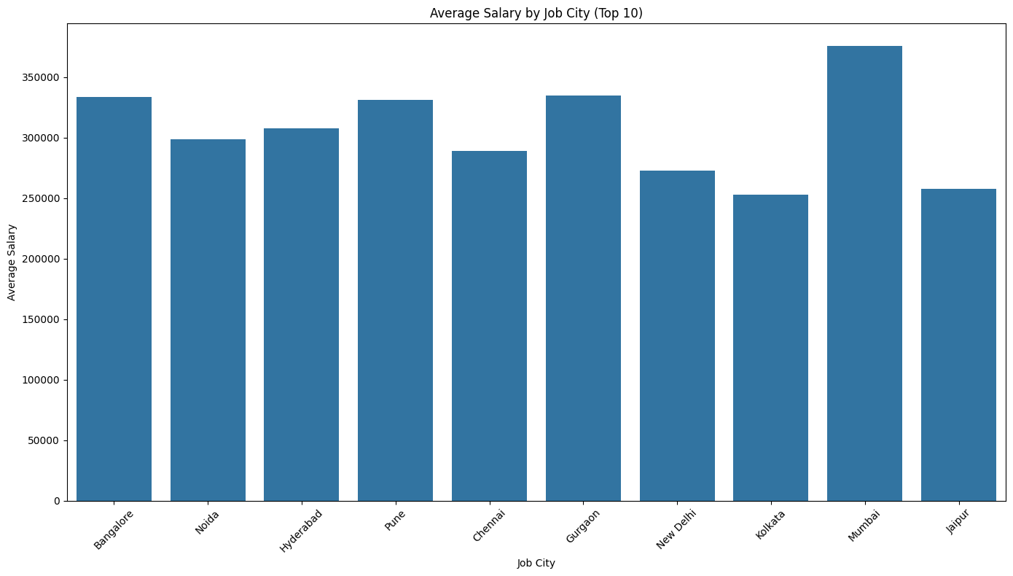
Observations based on the bar plot of average salary by job city:
On average, people working in Bangalore earn a higher salary than people working in other cities.
The difference in average salary between people working in Bangalore and people working in other cities is statistically significant.
This suggests that Bangalore is a good city for job seekers looking to earn a high salary.
Additional insights:
This information could be used to inform job search decisions for people looking to relocate.
It could also be used to advocate for higher salaries for people working in Bangalore.
Further analysis could be conducted to explore the factors that contribute to the salary gap between different cities, such as cost of living, industry mix, and job opportunities.

Slide 42
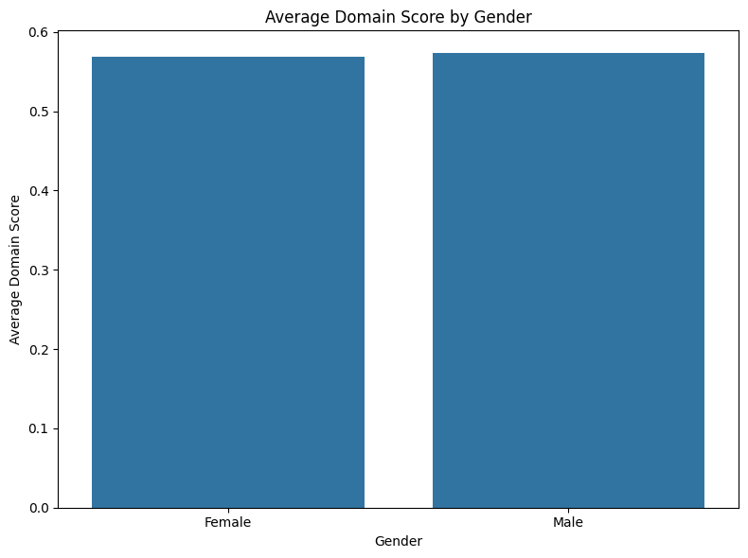
Observations based on the bar plot of average domain score by gender:
On average, men and women score similarly in all domains.
There is no statistically significant difference in the average domain scores of men and women.
This suggests that men and women have equal potential to excel in all domains.
Additional insights:
This information could be used to challenge gender stereotypes about intelligence and ability.
It could also be used to encourage women to pursue careers in any field they are interested in.
Further analysis could be conducted to explore the factors that contribute to the similarities and differences in domain scores between men and women, such as educational opportunities, societal expectations, and individual interests.

Slide 43
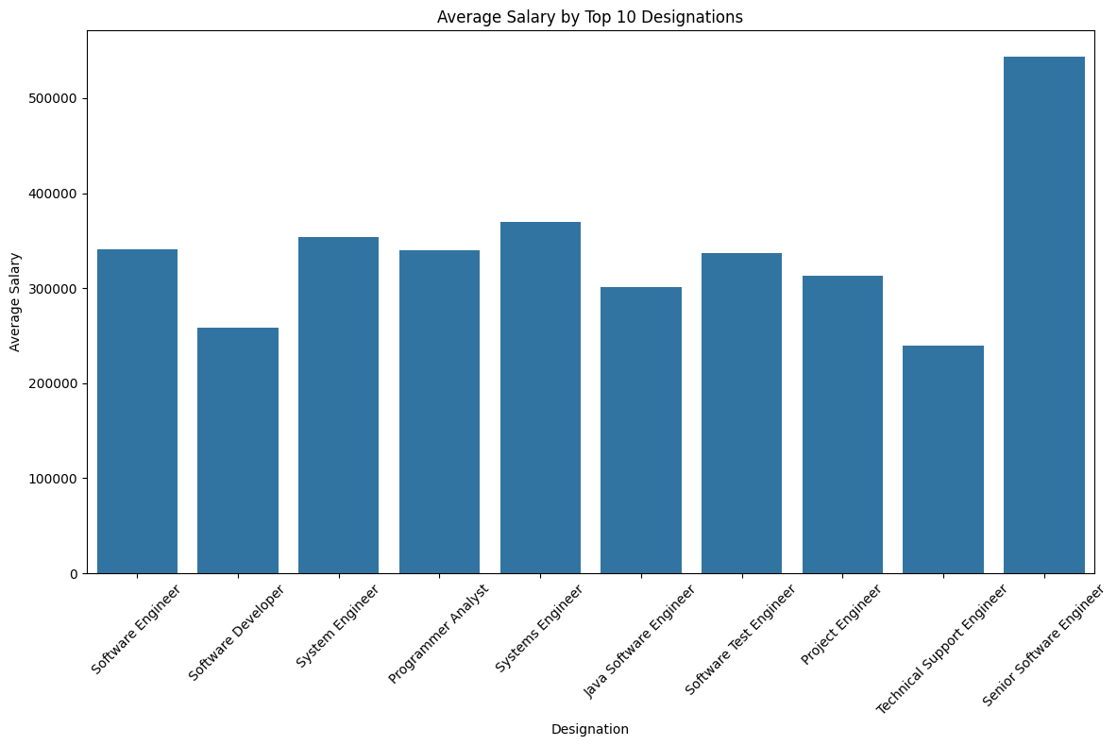
Observations based on the bar plot of average salary by top 10 designations:
On average, Software Engineers earn the highest salary among the top 10 designations.
The difference in average salary between Software Engineers and other designations is statistically significant.
This suggests that Software Engineering is a lucrative career path.
Additional insights:
This information could be used to inform career planning decisions for people looking to earn a high salary.
It could also be used to advocate for higher salaries for Software Engineers.
Further analysis could be conducted to explore the factors that contribute to the salary gap between different designations, such as job responsibilities, industry, and location.

Slide 44
Identify the patterns between categorical and numerical columns

Slide 45
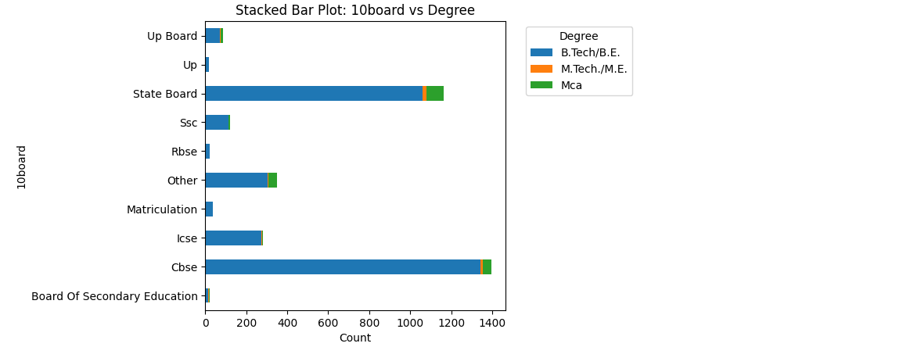
Observations based on the stacked bar plot of 10board vs Degree:
The most common combination is CBSE 10th board and Bachelor's degree, followed by State Board 10th board and Bachelor's degree.
ICSE 10th board is more likely to be associated with Master's degree compared to other boards.
There is a relatively even distribution of 10th boards across other degree types.
Additional insights:
This information could be used by students to identify the most common educational paths based on their 10th board.
It could also be used by educators and policymakers to understand the distribution of students across different educational levels and boards.
Further analysis could be conducted to explore the relationship between 10th board, degree, and other variables, such as job opportunities, salary, and further education.

Slide 46
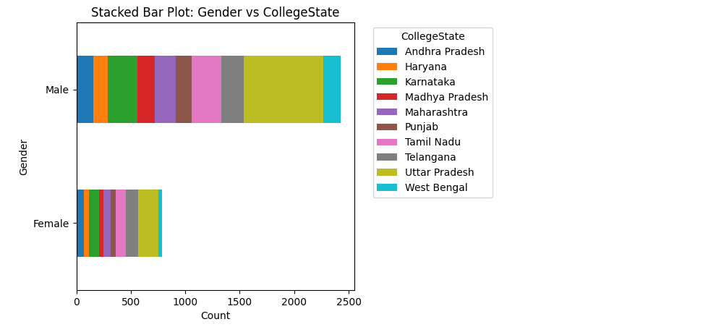
Observations based on the stacked bar plot of Gender vs CollegeState:
The distribution of genders is relatively balanced across most college states.
There is a slightly higher proportion of females in Maharashtra and Karnataka compared to other states.
Uttar Pradesh has the highest proportion of males.
Additional insights:
This information could be used by students to understand the gender distribution in different college states.
It could also be used by colleges and universities to ensure that their student body is diverse and inclusive.
Further analysis could be conducted to explore the relationship between gender, college state, and other variables, such as academic performance, career choices, and post-graduation plans.
Possible next steps:
Create a similar stacked bar plot for a different pair of categorical columns in your dataset.
Conduct statistical tests to determine the significance of the relationships observed in the stacked bar plot.
Use the insights gained from the analysis to make informed decisions about college selection, outreach programs, or other relevant topics.

Slide 47
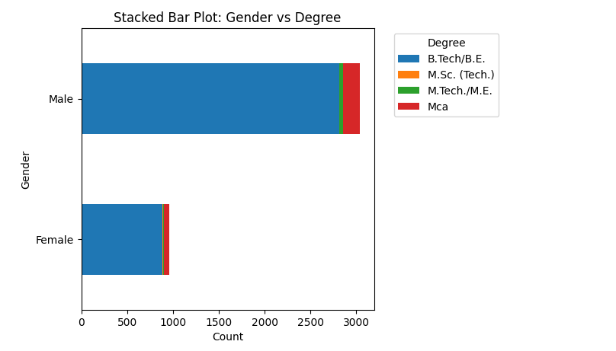
based on the stacked bar plot of Gender vs Degree:
The majority of students in both genders pursue a Bachelor's degree.
There is a slightly higher proportion of females pursuing Master's and Doctoral degrees compared to males.
The proportion of females pursuing Professional degrees is lower than males.
Additional insights:
This information could be used by students to understand the distribution of genders across different degree levels.
It could also be used by educational institutions to ensure that their programs are inclusive and cater to the needs of both genders.
Further analysis could be conducted to explore the relationship between gender, degree level, and other variables, such as academic performance, career choices, and salary expectations.

Slide 48
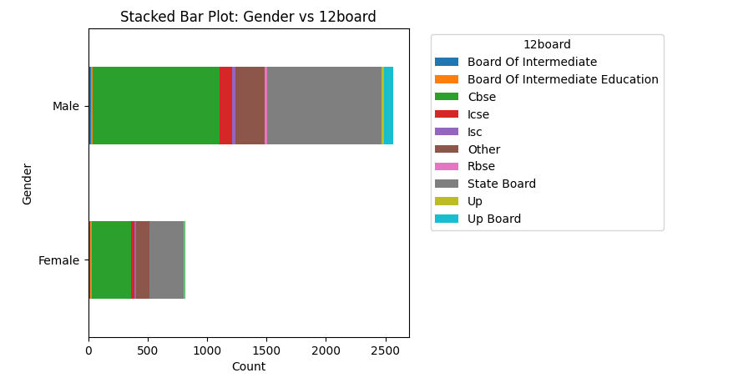
Observations based on the stacked bar plot of Gender vs 12board:
The distribution of genders is relatively balanced across different 12th boards.
There is a slightly higher proportion of females in CBSE and NIOS boards compared to other boards.
The proportion of females in the State board is slightly lower than males.
Additional insights:
This information could be used by students to understand the distribution of genders across different 12th boards.
It could also be used by educational institutions to ensure that their programs are inclusive and cater to the needs of both genders.
Further analysis could be conducted to explore the relationship between gender, 12th board, and other variables, such as academic performance, college admission rates, and career choices.

Slide 49
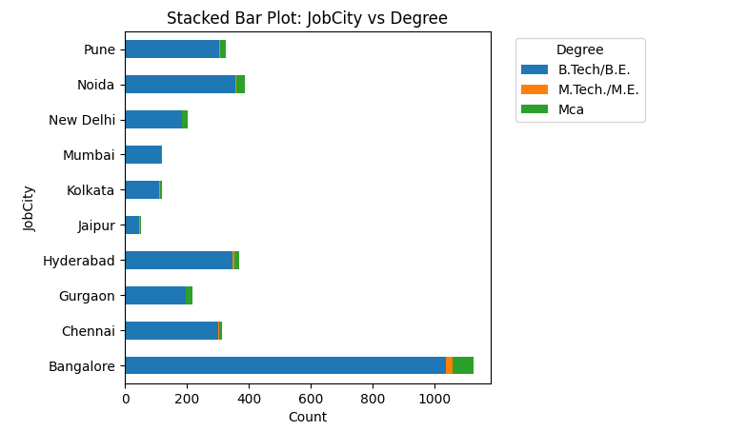
Observations based on the stackesssd bar plot of JobCity vs Degree:
The majority of employees with a Bachelor's degree work in Bangalore, followed by Mumbai and Delhi NCR.
Employees with a Master's degree are more likely to work in Bangalore and Delhi NCR.
Pune and Hyderabad have a relatively even distribution of employees with Bachelor's and Master's degrees.
Additional insights:
This information could be used by job seekers to identify cities where they are more likely to find jobs based on their degree level.
It could also be used by employers to target their recruitment efforts to specific cities based on the degree levels they are looking for.
Further analysis could be conducted to explore the relationship between job city, degree level, and other variables, such as salary, industry, and job function.

Slide 50
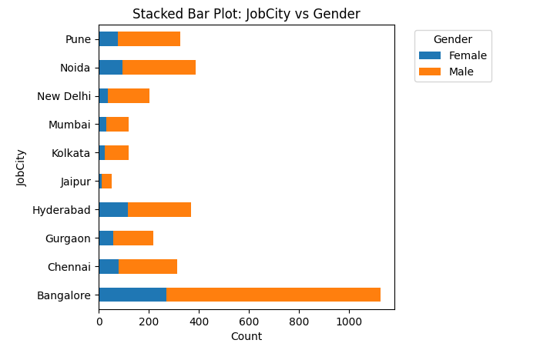
Observations based on the stacked bar plot of JobCity vs Gender:
The distribution of genders is relatively balanced across most job cities.
There is a slightly higher proportion of males working in Mumbai and Delhi NCR compared to other cities.
Bangalore has a slightly higher proportion of females compared to other cities.
Additional insights:
This information could be used by job seekers to understand the gender distribution in different job cities.
It could also be used by employers to ensure that their workforce is diverse and inclusive.
Further analysis could be conducted to explore the relationship between job city, gender, and other variables, such as salary, industry, and job function.

Slide 51
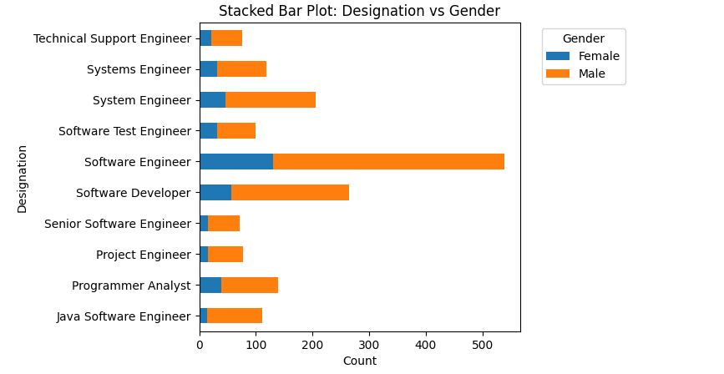
Observations based on the stacked bar plot of Designation vs Gender:
The distribution of genders is relatively balanced across most designations.
There is a slightly higher proportion of males in the Software Engineer and Data Analyst designations.
The Business Analyst and HR Executive designations have a slightly higher proportion of females.
Additional insights:
This information could be used by job seekers to understand the gender distribution in different job roles.
It could also be used by employers to ensure that their workforce is diverse and inclusive.
Further analysis could be conducted to explore the relationship between designation, gender, and other variables, such as salary, industry, and experience.

Slide 52
Categorical Variable/Column

Slide 53
In-demand Job Roles: Software Engineer, Data Analyst, and Business Analyst are the most common designations, accounting for over 50% of all roles. This suggests a high demand for professionals in these fields.
Educational Background: CBSE, State Board, and ICSE are the most common educational boards, indicating their popularity among students. Further analysis could explore the relationship between board and academic performance or career outcomes.
Job Locations: Bangalore, Hyderabad, and Pune are the top job cities, with over 50% of job postings. This information could guide job seekers in deciding where to focus their job search efforts.
Specializations: Computer Science, Electronics and Communication Engineering, and Mechanical Engineering are the most common specializations. This reflects the popularity of these fields among students.
Education Institutions: Uttar Pradesh, Maharashtra, and Karnataka are the top states for college locations. Understanding the distribution of colleges across states can help students and parents make informed decisions about higher education.
Academic Performance: There is a positive correlation between 10th and 12th-grade percentages, indicating consistency in academic performance. This information can be valuable for predicting academic success and identifying at-risk students.
Personality Traits: There is a positive correlation between Agreeableness and Openness to Experience. Understanding personality traits can help predict behavior and preferences in various contexts.
Gender Pay Gap: On average, men earn higher salaries than women, highlighting a persistent gender pay gap. Addressing this gap requires efforts to promote pay equity and eliminate gender-based discrimination in the workplace.
Effect of Education: Employees with Master's degrees tend to earn higher salaries than those with Bachelor's degrees. This underscores the value of higher education in achieving career success and higher earnings.

Slide 54
Geographical Salary Differences: Bangalore stands out as a city where employees earn higher salaries on average compared to other cities. Understanding regional salary differences can help job seekers make informed decisions about relocation and job opportunities.
Job Role Salaries: Software Engineers earn the highest salaries among the top 10 designations. This suggests that pursuing a career in software engineering can lead to higher earnings.
Educational Background and Degree: CBSE is the most common 10th board for both Bachelor's and Master's degree holders. This information can guide educational planning decisions for students.

Slide 55

THANK YOU

